Slide 1
Python environment and package management
By Shahbaz Chaudhary

Slide 2


Package managers download and install packages, and their dependencies
Python has two main package managers:
pip (the official package manager)
conda (the one most data scientists use)
This is what you should use

Slide 3
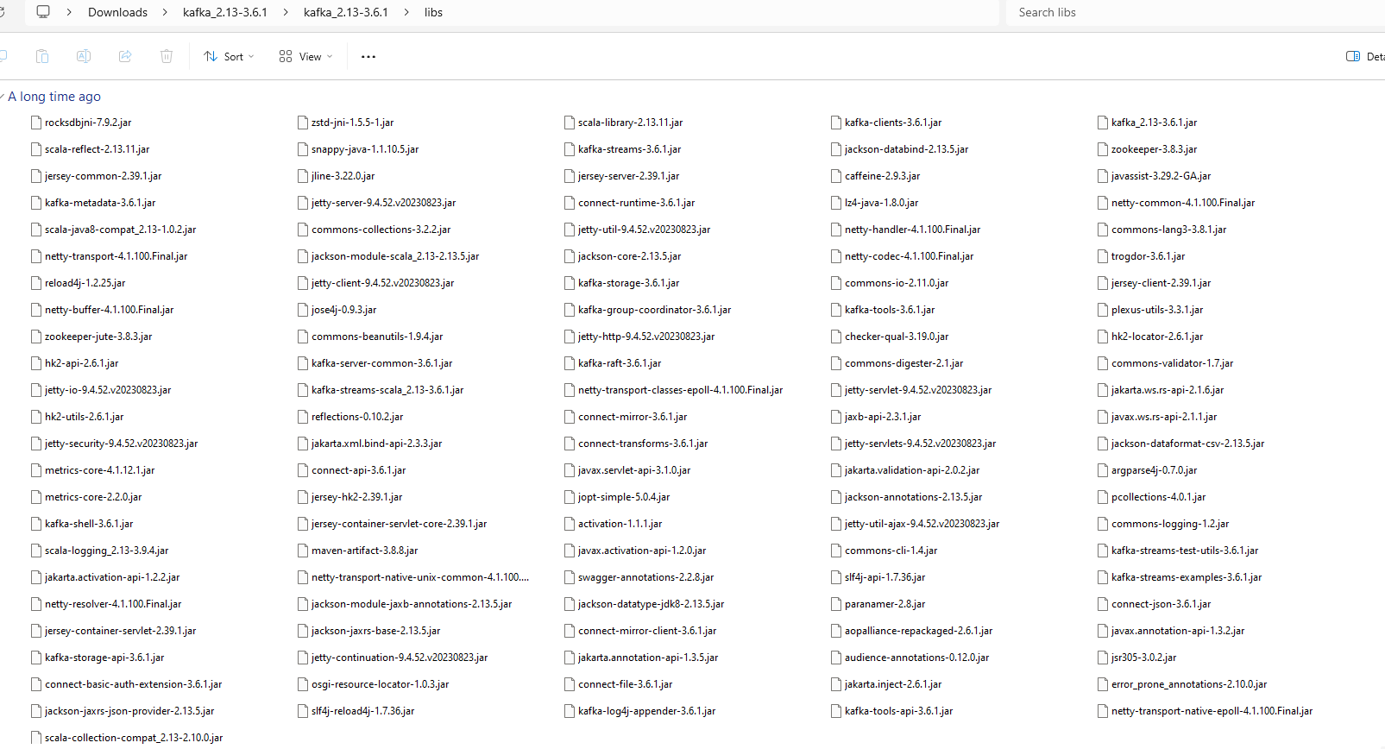
Before package managers Every software came with all dependencies (leading to duplication)

Slide 4
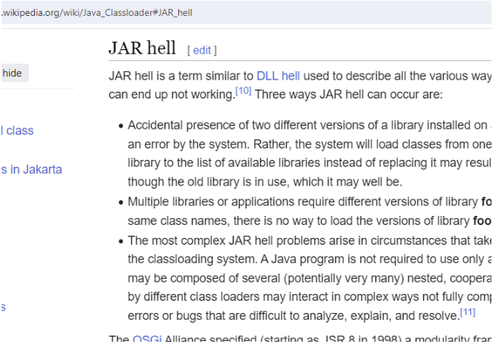
Sometimes there were mismatches with libraries

Slide 5



The world is full of package managers
apt install software
brew install –cask software
chocolatey install software
yum install software

Slide 6
Package management

Slide 7
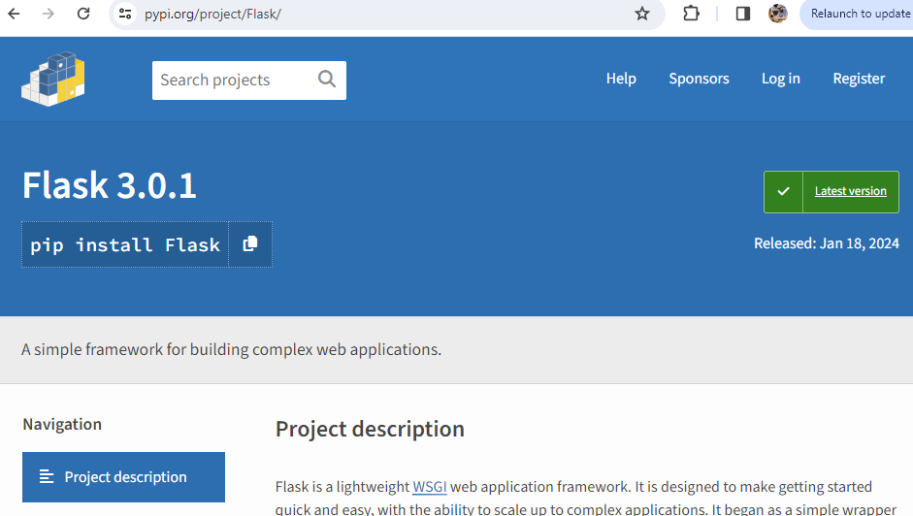
Python’s official package manager is pip pypi.org is the official repo with over half a million packages

Slide 8
Let’s try pip First create an experimental environment (explained later)
Create* new environment to protect your existing system
conda create --name adv_python python=3.10
Activate this environment (aka ‘enter’ it)
conda activate adv_python
Confirm the current env
conda env list
(base) C:\Users\shahb>conda env list
# conda environments:
#
base C:\Users\shahb\anaconda3
adv_python * C:\Users\shahb\anaconda3\envs\adv_python
*Delete this environment, if needed: conda env remove --name adv_python

Slide 9
Try installing a package
List all pip packages installed in this env
pip list
(adv_python) C:\Users\shahb>pip list
Package Version
---------- -------
pip 23.3.1
setuptools 68.2.2
wheel 0.41.2
Install a package
pip install tqdm
Collecting tqdm
Downloading tqdm-4.66.1-py3-none-any.whl.metadata (57 kB)
━━━━━━━━━━━━━━━━━━━━━━━━━━━━━━━━━━━━━━━━ 57.6/57.6 kB 607.3 kB/s eta 0:00:00
Requirement already satisfied: colorama in c:\users\shahb\anaconda3\envs\adv_python\lib\site-packages (from tqdm) (0.4.6)
Downloading tqdm-4.66.1-py3-none-any.whl (78 kB)
━━━━━━━━━━━━━━━━━━━━━━━━━━━━━━━━━━━━━━━━ 78.3/78.3 kB 2.2 MB/s eta 0:00:00
Installing collected packages: tqdm
Successfully installed tqdm-4.66.1
(adv_python) C:\Users\shahb>pip list
Package Version
---------- -------
colorama 0.4.6
pip 23.3.1
setuptools 68.2.2
tqdm 0.41.2
wheel 0.41.2
Check again
pip list

Slide 10
Packages are only downloaded once
I recreated the environment and re-installed the package
conda env remove --name adv_python
conda create --name adv_python python=3.10
conda activate adv_python
pip install tqdm
Collecting tqdm
Using cached tqdm-4.66.1-py3-none-any.whl.metadata (57 kB)
Collecting colorama (from tqdm)
Using cached colorama-0.4.6-py2.py3-none-any.whl (25 kB)
Using cached tqdm-4.66.1-py3-none-any.whl (78 kB)
Installing collected packages: colorama, tqdm
Successfully installed colorama-0.4.6 tqdm-4.66.1
New install
Collecting tqdm
Downloading tqdm-4.66.1-py3-none-any.whl.metadata (57 kB)
━━━━━━━━━━━━━━━━━━━━━━━━━━━━━━━━━━━━━━━━ 57.6/57.6 kB 607.3 kB/s eta 0:00:00
Requirement already satisfied: colorama in c:\users\shahb\anaconda3\envs\adv_python\lib\site-packages (from tqdm) (0.4.6)
Downloading tqdm-4.66.1-py3-none-any.whl (78 kB)
━━━━━━━━━━━━━━━━━━━━━━━━━━━━━━━━━━━━━━━━ 78.3/78.3 kB 2.2 MB/s eta 0:00:00
Installing collected packages: tqdm
Successfully installed tqdm-4.66.1
Old install

Slide 11
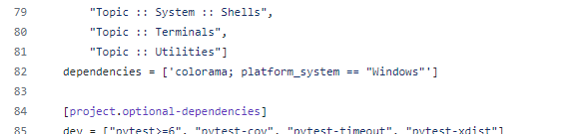
Why is colorama installed?
Because tqdm lists colorama as a dependency in
https://github.com/tqdm/tqdm/blob/master/pyproject.toml

Slide 12
pip downloads a wheel (.whl) file, which contains
Meta-data
/flask-3.0.2.dist-info
/flask-3.0.2.dist-info/entry_points.txt
/flask-3.0.2.dist-info/LICENSE.rst
/flask-3.0.2.dist-info/METADATA
/flask-3.0.2.dist-info/RECORD
/flask-3.0.2.dist-info/WHEEL
Actual code
/flask
/flask/app.py
/flask/blueprints.py
/flask/cli.py
/flask/config.py
/flask/ctx.py
/flask/debughelpers.py
/flask/globals.py
/flask/helpers.py
/flask/json
/flask/json/provider.py
/flask/json/tag.py
/flask/json/__init__.py
/flask/logging.py
/flask/py.typed
/flask/sansio
/flask/sansio/app.py
/flask/sansio/blueprints.py
/flask/sansio/README.md
/flask/sansio/scaffold.py
/flask/sessions.py
/flask/signals.py
/flask/templating.py
/flask/testing.py
/flask/typing.py
/flask/views.py
/flask/wrappers.py
/flask/__init__.py
/flask/__main__.py

Slide 13
Definition
pip downloads, caches and installs python packages and their dependencies Caveats
For many years, pip was not able to install packages with binary dependencies, such as numpy
pip also doesn’t do a thorough job of making sure all packages and their dependencies will work well together
Great resource: https://jakevdp.github.io/blog/2016/08/25/conda-myths-and-misconceptions/

Slide 14
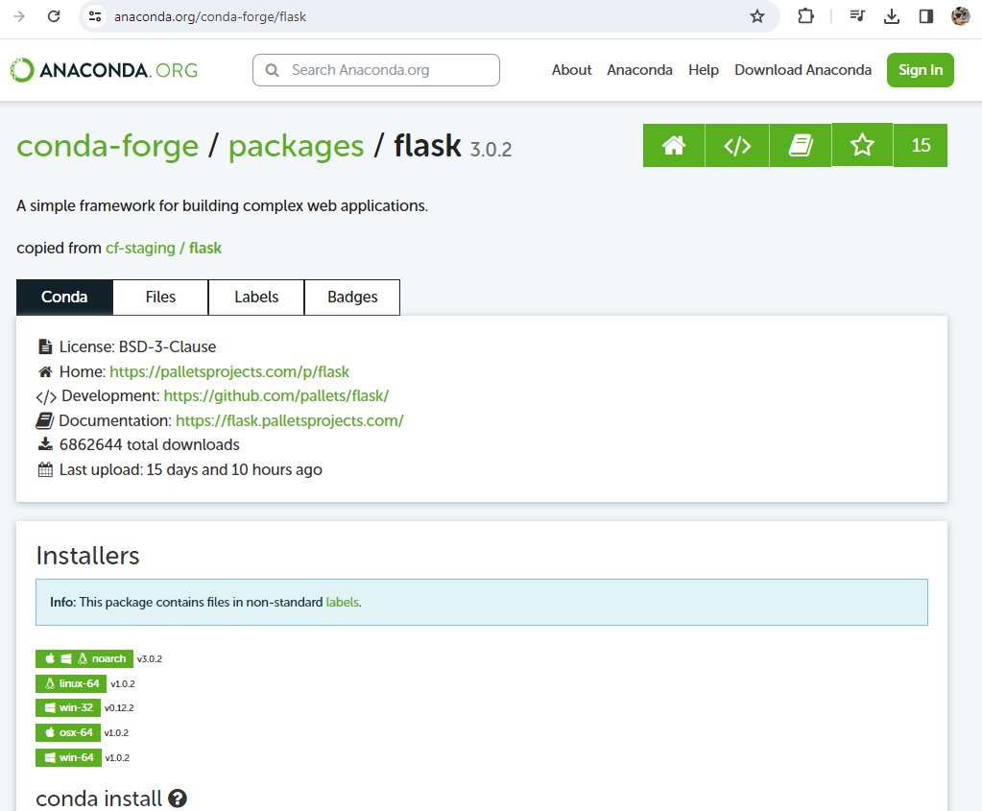
Data scientists generally use conda as their package manager*, along with pip
Anaonda’s conda and conda-forge repos host around 28k packages
https://anaconda.org/anaconda : 3,399
https://anaconda.org/conda-forge: 24,421
*Conda is also an env manager, as we will see

Slide 15
conda is (currently) the premier package (and environment) manager for data scientists
Unlike pip, it can install packages of any language. In that sense, it is closer to apt/brew/chocolatey.
It can manage non-python dependencies, such as numpy’s c based libraries (although pip can also do this now)
It has a very powerful solver. When you install packages
conda install package_a package_b package_c
It will make sure all three packages can work with existing libraries in the environment, they can work with each other and all dependencies can work with all other dependencies! You are less likely to have version mismatch issues.
Caveats
Sometimes dependency resolution can result in extremely (unbearably) long wait times to install packages. So much so that a new project has started up: mamba (https://github.com/mamba-org/mamba). As of late 2023, some features of mamba have been included in conda.

Slide 16
conda downloads a .conda file, which contains
Actual code
/pkg-flask-3.0.2-pyhd8ed1ab_0/site-packages/flask
/pkg-flask-3.0.2-pyhd8ed1ab_0/site-packages/flask/app.py
/pkg-flask-3.0.2-pyhd8ed1ab_0/site-packages/flask/blueprints.py
/pkg-flask-3.0.2-pyhd8ed1ab_0/site-packages/flask/cli.py
/pkg-flask-3.0.2-pyhd8ed1ab_0/site-packages/flask/config.py
/pkg-flask-3.0.2-pyhd8ed1ab_0/site-packages/flask/ctx.py
/pkg-flask-3.0.2-pyhd8ed1ab_0/site-packages/flask/debughelpers.py
/pkg-flask-3.0.2-pyhd8ed1ab_0/site-packages/flask/globals.py
/pkg-flask-3.0.2-pyhd8ed1ab_0/site-packages/flask/helpers.py
/pkg-flask-3.0.2-pyhd8ed1ab_0/site-packages/flask/json
/pkg-flask-3.0.2-pyhd8ed1ab_0/site-packages/flask/json/provider.py
/pkg-flask-3.0.2-pyhd8ed1ab_0/site-packages/flask/json/tag.py
/pkg-flask-3.0.2-pyhd8ed1ab_0/site-packages/flask/json/__init__.py
/pkg-flask-3.0.2-pyhd8ed1ab_0/site-packages/flask/logging.py
/pkg-flask-3.0.2-pyhd8ed1ab_0/site-packages/flask/py.typed
/pkg-flask-3.0.2-pyhd8ed1ab_0/site-packages/flask/sansio
/pkg-flask-3.0.2-pyhd8ed1ab_0/site-packages/flask/sansio/app.py
/pkg-flask-3.0.2-pyhd8ed1ab_0/site-packages/flask/sansio/blueprints.py
/pkg-flask-3.0.2-pyhd8ed1ab_0/site-packages/flask/sansio/README.md
/pkg-flask-3.0.2-pyhd8ed1ab_0/site-packages/flask/sansio/scaffold.py
/pkg-flask-3.0.2-pyhd8ed1ab_0/site-packages/flask/sessions.py
/pkg-flask-3.0.2-pyhd8ed1ab_0/site-packages/flask/signals.py
/pkg-flask-3.0.2-pyhd8ed1ab_0/site-packages/flask/templating.py
/pkg-flask-3.0.2-pyhd8ed1ab_0/site-packages/flask/testing.py
/pkg-flask-3.0.2-pyhd8ed1ab_0/site-packages/flask/typing.py
/pkg-flask-3.0.2-pyhd8ed1ab_0/site-packages/flask/views.py
/pkg-flask-3.0.2-pyhd8ed1ab_0/site-packages/flask/wrappers.py
/pkg-flask-3.0.2-pyhd8ed1ab_0/site-packages/flask/__init__.py
/pkg-flask-3.0.2-pyhd8ed1ab_0/site-packages/flask/__main__.py
Meta-data
/info-flask-3.0.2-pyhd8ed1ab_0
/info-flask-3.0.2-pyhd8ed1ab_0/info
/info-flask-3.0.2-pyhd8ed1ab_0/info/about.json
/info-flask-3.0.2-pyhd8ed1ab_0/info/files
/info-flask-3.0.2-pyhd8ed1ab_0/info/git
/info-flask-3.0.2-pyhd8ed1ab_0/info/hash_input.json
/info-flask-3.0.2-pyhd8ed1ab_0/info/index.json
/info-flask-3.0.2-pyhd8ed1ab_0/info/link.json
/info-flask-3.0.2-pyhd8ed1ab_0/info/paths.json
/info-flask-3.0.2-pyhd8ed1ab_0/info/recipe
/info-flask-3.0.2-pyhd8ed1ab_0/info/recipe/conda_build_config.yaml
/info-flask-3.0.2-pyhd8ed1ab_0/info/recipe/meta.yaml
/info-flask-3.0.2-pyhd8ed1ab_0/info/recipe/meta.yaml.template
/info-flask-3.0.2-pyhd8ed1ab_0/info/recipe/recipe-scripts-license.txt
/info-flask-3.0.2-pyhd8ed1ab_0/info/test
/info-flask-3.0.2-pyhd8ed1ab_0/info/test/run_test.bat
/info-flask-3.0.2-pyhd8ed1ab_0/info/test/run_test.py
/info-flask-3.0.2-pyhd8ed1ab_0/info/test/run_test.sh
/info-flask-3.0.2-pyhd8ed1ab_0/info/test/test_time_dependencies.json
/info-flask-3.0.2-pyhd8ed1ab_0.tar.zst
/metadata.json
/pkg-flask-3.0.2-pyhd8ed1ab_0
/pkg-flask-3.0.2-pyhd8ed1ab_0/info
/pkg-flask-3.0.2-pyhd8ed1ab_0/info/licenses
/pkg-flask-3.0.2-pyhd8ed1ab_0/info/licenses/LICENSE.rst
/pkg-flask-3.0.2-pyhd8ed1ab_0/site-packages/flask-3.0.2.dist-info
/pkg-flask-3.0.2-pyhd8ed1ab_0/site-packages/flask-3.0.2.dist-info/direct_url.json
/pkg-flask-3.0.2-pyhd8ed1ab_0/site-packages/flask-3.0.2.dist-info/entry_points.txt
/pkg-flask-3.0.2-pyhd8ed1ab_0/site-packages/flask-3.0.2.dist-info/INSTALLER
/pkg-flask-3.0.2-pyhd8ed1ab_0/site-packages/flask-3.0.2.dist-info/LICENSE.rst
/pkg-flask-3.0.2-pyhd8ed1ab_0/site-packages/flask-3.0.2.dist-info/METADATA
/pkg-flask-3.0.2-pyhd8ed1ab_0/site-packages/flask-3.0.2.dist-info/RECORD
/pkg-flask-3.0.2-pyhd8ed1ab_0/site-packages/flask-3.0.2.dist-info/REQUESTED

Slide 17
.conda vs pip’s .whl file
CONDA code | PIP
/pkg-flask-3.0.2-pyhd8ed1ab_0/site-packages | /flask
/pkg-flask-3.0.2-pyhd8ed1ab_0/site-packages | /flask/__init__.py
/pkg-flask-3.0.2-pyhd8ed1ab_0/site-packages/flask | /flask/__main__.py
/pkg-flask-3.0.2-pyhd8ed1ab_0/site-packages/flask/__init__.py | /flask/app.py
/pkg-flask-3.0.2-pyhd8ed1ab_0/site-packages/flask/__main__.py | /flask/blueprints.py
/pkg-flask-3.0.2-pyhd8ed1ab_0/site-packages/flask/app.py | /flask/cli.py
/pkg-flask-3.0.2-pyhd8ed1ab_0/site-packages/flask/blueprints.py | /flask/config.py
/pkg-flask-3.0.2-pyhd8ed1ab_0/site-packages/flask/cli.py | /flask/ctx.py
/pkg-flask-3.0.2-pyhd8ed1ab_0/site-packages/flask/config.py | /flask/debughelpers.py
/pkg-flask-3.0.2-pyhd8ed1ab_0/site-packages/flask/ctx.py | /flask/globals.py
/pkg-flask-3.0.2-pyhd8ed1ab_0/site-packages/flask/debughelpers.py | /flask/helpers.py
/pkg-flask-3.0.2-pyhd8ed1ab_0/site-packages/flask/globals.py | /flask/json
/pkg-flask-3.0.2-pyhd8ed1ab_0/site-packages/flask/helpers.py | /flask/json/__init__.py
/pkg-flask-3.0.2-pyhd8ed1ab_0/site-packages/flask/json | /flask/json/provider.py
/pkg-flask-3.0.2-pyhd8ed1ab_0/site-packages/flask/json/__init__.py | /flask/json/tag.py
/pkg-flask-3.0.2-pyhd8ed1ab_0/site-packages/flask/json/provider.py | /flask/logging.py
/pkg-flask-3.0.2-pyhd8ed1ab_0/site-packages/flask/json/tag.py | /flask/py.typed
/pkg-flask-3.0.2-pyhd8ed1ab_0/site-packages/flask/logging.py | /flask/sansio
/pkg-flask-3.0.2-pyhd8ed1ab_0/site-packages/flask/py.typed | /flask/sansio/app.py
/pkg-flask-3.0.2-pyhd8ed1ab_0/site-packages/flask/sansio | /flask/sansio/blueprints.py
/pkg-flask-3.0.2-pyhd8ed1ab_0/site-packages/flask/sansio/app.py | /flask/sansio/README.md
/pkg-flask-3.0.2-pyhd8ed1ab_0/site-packages/flask/sansio/blueprints.py | /flask/sansio/scaffold.py
/pkg-flask-3.0.2-pyhd8ed1ab_0/site-packages/flask/sansio/README.md | /flask/sessions.py
/pkg-flask-3.0.2-pyhd8ed1ab_0/site-packages/flask/sansio/scaffold.py | /flask/signals.py
/pkg-flask-3.0.2-pyhd8ed1ab_0/site-packages/flask/sessions.py | /flask/templating.py
/pkg-flask-3.0.2-pyhd8ed1ab_0/site-packages/flask/signals.py | /flask/testing.py
/pkg-flask-3.0.2-pyhd8ed1ab_0/site-packages/flask/templating.py | /flask/typing.py
/pkg-flask-3.0.2-pyhd8ed1ab_0/site-packages/flask/testing.py | /flask/views.py
/pkg-flask-3.0.2-pyhd8ed1ab_0/site-packages/flask/typing.py | /flask/wrappers.py
/pkg-flask-3.0.2-pyhd8ed1ab_0/site-packages/flask/views.py | PIP metadata
/pkg-flask-3.0.2-pyhd8ed1ab_0/site-packages/flask/wrappers.py | /flask-3.0.2.dist-info
/pkg-flask-3.0.2-pyhd8ed1ab_0/site-packages/flask-3.0.2.dist-info | /flask-3.0.2.dist-info/entry_points.txt
/pkg-flask-3.0.2-pyhd8ed1ab_0/site-packages/flask-3.0.2.dist-info/direct_url.json
/pkg-flask-3.0.2-pyhd8ed1ab_0/site-packages/flask-3.0.2.dist-info/entry_points.txt | /flask-3.0.2.dist-info/LICENSE.rst
/pkg-flask-3.0.2-pyhd8ed1ab_0/site-packages/flask-3.0.2.dist-info/INSTALLER | /flask-3.0.2.dist-info/METADATA
/pkg-flask-3.0.2-pyhd8ed1ab_0/site-packages/flask-3.0.2.dist-info/LICENSE.rst | /flask-3.0.2.dist-info/RECORD
/pkg-flask-3.0.2-pyhd8ed1ab_0/site-packages/flask-3.0.2.dist-info/METADATA
/pkg-flask-3.0.2-pyhd8ed1ab_0/site-packages/flask-3.0.2.dist-info/RECORD | /flask-3.0.2.dist-info/WHEEL
/pkg-flask-3.0.2-pyhd8ed1ab_0/site-packages/flask-3.0.2.dist-info/REQUESTED
Meta data files
CONDA metadata
/info-flask-3.0.2-pyhd8ed1ab_0
/info-flask-3.0.2-pyhd8ed1ab_0.tar.zst
/info-flask-3.0.2-pyhd8ed1ab_0/info
/info-flask-3.0.2-pyhd8ed1ab_0/info/about.json
/info-flask-3.0.2-pyhd8ed1ab_0/info/files
/info-flask-3.0.2-pyhd8ed1ab_0/info/git
/info-flask-3.0.2-pyhd8ed1ab_0/info/hash_input.json
/info-flask-3.0.2-pyhd8ed1ab_0/info/index.json
/info-flask-3.0.2-pyhd8ed1ab_0/info/link.json
/info-flask-3.0.2-pyhd8ed1ab_0/info/paths.json
/info-flask-3.0.2-pyhd8ed1ab_0/info/recipe
/info-flask-3.0.2-pyhd8ed1ab_0/info/recipe/conda_build_config.yaml
/info-flask-3.0.2-pyhd8ed1ab_0/info/recipe/meta.yaml
/info-flask-3.0.2-pyhd8ed1ab_0/info/recipe/meta.yaml.template
/info-flask-3.0.2-pyhd8ed1ab_0/info/recipe/recipe-scripts-license.txt
/info-flask-3.0.2-pyhd8ed1ab_0/info/test
/info-flask-3.0.2-pyhd8ed1ab_0/info/test/run_test.bat
/info-flask-3.0.2-pyhd8ed1ab_0/info/test/run_test.py
/info-flask-3.0.2-pyhd8ed1ab_0/info/test/run_test.sh
/info-flask-3.0.2-pyhd8ed1ab_0/info/test/test_time_dependencies.json
/metadata.json
/pkg-flask-3.0.2-pyhd8ed1ab_0
/pkg-flask-3.0.2-pyhd8ed1ab_0/info
/pkg-flask-3.0.2-pyhd8ed1ab_0/info/licenses
/pkg-flask-3.0.2-pyhd8ed1ab_0/info/licenses/LICENSE.rst

Slide 18
Modern conda and pip work well together
pip install tqdm
conda install flask
(adv_python2) C:\Users\shahb>python
Python 3.12.1 | packaged by Anaconda, Inc. | (main, Jan 19 2024, 15:44:08) [MSC v.1916 64 bit (AMD64)] on win32
Type "help", "copyright", "credits" or "license" for more information.
>>> import tqdm, flask
>>> tqdm.__file__
'C:\\Users\\shahb\\anaconda3\\envs\\adv_python2\\Lib\\site-packages\\tqdm\\__init__.py'
>>> flask.__file__
'C:\\Users\\shahb\\anaconda3\\envs\\adv_python2\\Lib\\site-packages\\flask\\__init__.py'

Slide 19
pip install flask vs conda install flask
flask_conda/Lib/site-packages/Jinja2-3.1.3.dist-info: | REQUESTED
flask_conda/Lib/site-packages/Jinja2-3.1.3.dist-info: | direct_url.json
flask_conda/Lib/site-packages/click-8.1.7.dist-info: | REQUESTED
flask_conda/Lib/site-packages/click-8.1.7.dist-info: | direct_url.json
flask_conda/Lib/site-packages/colorama-0.4.6.dist-info: | REQUESTED
flask_conda/Lib/site-packages/colorama-0.4.6.dist-info: | direct_url.json
flask_conda/Lib/site-packages/flask/__pycache__: | scaffold.cpython-310.pyc
flask_conda/Lib/site-packages/flask: | scaffold.py
flask_conda/Lib/site-packages/itsdangerous/__pycache__: | jws.cpython-310.pyc
flask_conda/Lib/site-packages/itsdangerous: | jws.py
flask_conda/Lib/site-packages: | Flask-2.2.5.dist-info |  | flask_pip/Lib/site-packages: | flask-3.0.2.dist-info
flask_conda/Lib/site-packages: | MarkupSafe-2.1.3.dist-info |  | flask_pip/Lib/site-packages: | MarkupSafe-2.1.5.dist-info
flask_conda/Lib/site-packages: | itsdangerous-2.0.1.dist-info |  | flask_pip/Lib/site-packages: | itsdangerous-2.1.2.dist-info
flask_conda/Lib/site-packages: | werkzeug-2.3.8.dist-info |  | flask_pip/Lib/site-packages: | werkzeug-3.0.1.dist-info
flask_conda/Scripts: | flask-script.py
flask_conda/conda-meta: | click-8.1.7-py310haa95532_0.json
flask_conda/conda-meta: | colorama-0.4.6-py310haa95532_0.json
flask_conda/conda-meta: | flask-2.2.5-py310haa95532_0.json
flask_conda/conda-meta: | itsdangerous-2.0.1-pyhd3eb1b0_0.json
flask_conda/conda-meta: | jinja2-3.1.3-py310haa95532_0.json
flask_conda/conda-meta: | markupsafe-2.1.3-py310h2bbff1b_0.json
flask_conda/conda-meta: | werkzeug-2.3.8-py310haa95532_0.json
 |  |  | flask_pip/Lib/site-packages/colorama: | tests
 |  |  | flask_pip/Lib/site-packages/flask: | sansio
 |  |  | flask_pip/Lib/site-packages: | blinker
 |  |  | flask_pip/Lib/site-packages: | blinker-1.7.0.dist-info
Out of about 6.7k lines, only these differ
These lines only differ due to capitalization or version numbers
Only in conda
Only in pip

Slide 20
conda install flask vs pip install flask
conda env export
name: flask_pip
channels:
- defaults
dependencies:
- bzip2=1.0.8=he774522_0
- ca-certificates=2023.12.12=haa95532_0
- libffi=3.4.4=hd77b12b_0
- openssl=3.0.13=h2bbff1b_0
- pip=23.3.1=py310haa95532_0
- python=3.10.13=he1021f5_0
- setuptools=68.2.2=py310haa95532_0
- sqlite=3.41.2=h2bbff1b_0
- tk=8.6.12=h2bbff1b_0
- tzdata=2023d=h04d1e81_0
- vc=14.2=h21ff451_1
- vs2015_runtime=14.27.29016=h5e58377_2
- wheel=0.41.2=py310haa95532_0
- xz=5.4.5=h8cc25b3_0
- zlib=1.2.13=h8cc25b3_0
- pip:
- blinker==1.7.0
- click==8.1.7
- colorama==0.4.6
- flask==3.0.2
- itsdangerous==2.1.2
- jinja2==3.1.3
- markupsafe==2.1.5
- werkzeug==3.0.1
prefix: C:\Users\shahb\anaconda3\envs\flask_pip
name: flask_conda
channels:
- defaults
dependencies:
- bzip2=1.0.8=he774522_0
- ca-certificates=2023.12.12=haa95532_0
- click=8.1.7=py310haa95532_0
- colorama=0.4.6=py310haa95532_0
- flask=2.2.5=py310haa95532_0
- itsdangerous=2.0.1=pyhd3eb1b0_0
- jinja2=3.1.3=py310haa95532_0
- libffi=3.4.4=hd77b12b_0
- markupsafe=2.1.3=py310h2bbff1b_0
- openssl=3.0.13=h2bbff1b_0
- pip=23.3.1=py310haa95532_0
- python=3.10.13=he1021f5_0
- setuptools=68.2.2=py310haa95532_0
- sqlite=3.41.2=h2bbff1b_0
- tk=8.6.12=h2bbff1b_0
- tzdata=2023d=h04d1e81_0
- vc=14.2=h21ff451_1
- vs2015_runtime=14.27.29016=h5e58377_2
- werkzeug=2.3.8=py310haa95532_0
- wheel=0.41.2=py310haa95532_0
- xz=5.4.5=h8cc25b3_0
- zlib=1.2.13=h8cc25b3_0
prefix: C:\Users\shahb\anaconda3\envs\flask_conda
Conda env’s export file
Pip env’s export file

Slide 21
Modern conda and pip work well together
adv_python.yml
name: adv_python
channels:
- conda-forge
dependencies:
- python
- pandas
- numpy
- pip
- pip:
- pytorch
- flask
Generate an environment yaml file
conda env export > adv_python.yml
Create an environment based on the yaml file
conda env create -f adv_python.yml
Notice that you can have conda manage pip dependencies

Slide 22
conda is better at non-python dependency management
conda/pip install numpy result in the following package installations
The following NEW packages will be INSTALLED:
blas pkgs/main/win-64::blas-1.0-mkl
intel-openmp pkgs/main/win-64::intel-openmp-2023.1.0-h59b6b97_46320
mkl pkgs/main/win-64::mkl-2023.1.0-h6b88ed4_46358
mkl-service pkgs/main/win-64::mkl-service-2.4.0-py310h2bbff1b_1
mkl_fft pkgs/main/win-64::mkl_fft-1.3.8-py310h2bbff1b_0
mkl_random pkgs/main/win-64::mkl_random-1.2.4-py310h59b6b97_0
numpy pkgs/main/win-64::numpy-1.26.3-py310h055cbcc_0
numpy-base pkgs/main/win-64::numpy-base-1.26.3-py310h65a83cf_0
tbb pkgs/main/win-64::tbb-2021.8.0-h59b6b97_0
Conda
conda downloads many more dependencies!
Collecting numpy
Downloading numpy-1.26.4-cp310-cp310-win_amd64.whl (15.8 MB)
━━━━━━━━━━━━━━━━━━━━━━━━━━━━━━━━━━━━━━━━ 15.8/15.8 MB 7.8 MB/s eta 0:00:00
Installing collected packages: numpy
Successfully installed numpy-1.26.4
Pip
*Not all claims are true (any longer)

Slide 23
conda is better at non-python dependency management
Some packages are much better optimized (because of non-python dependencies)
Benchmark | conda | pip
Dotted 2 1024x1024 matrices | 0.01 s | 0.01 s
Dotted two 131,072 vectors | 0.05 ms | 0.16 ms
SVD of a 512x256 matrix | 0.03 s | 0.25 s
Cholesky decomposition of 512x512 matrix | 0.01 s | 0.01 s
Eigen decomposition of a 512x512 matrix | 0.47 s | 0.71 s
See appendix for test code
*Not all claims are true (any longer)

Slide 24
conda is better at non-python dependency management
conda is NOT just about Python. You can create an empty environment with NO python!
conda install r-essentials r-base
_r-mutex
…
ipykernel
ipython
jedi
jinja2
json5
jsonschema
jsonschema-specif~
jupyter-lsp
jupyter_client
jupyter_core
jupyter_events
jupyter_server
jupyter_server_te~
jupyterlab
jupyterlab_pygmen~
jupyterlab_server
libffi
…
r-askpass
r-assertthat
r-backports
r-base
r-base64enc
r-bh
r-boot
r-broom
r-callr
r-caret
r-cellranger
r-class
r-cli
r-clipr
r-cluster
r-codetools
r-colorspace
r-crayon
r-curl
r-data.table
r-dbi
r-dbplyr
r-dichromat
r-digest
r-dplyr
r-ellipsis
r-essentials
r-evaluate
r-fansi
r-forcats
r-foreach
r-foreign
r-formatr
r-fs
r-generics
r-ggplot2
r-glmnet
r-glue
r-gower
r-gtable
r-haven
r-hexbin
r-highr
r-hms
r-htmltools
r-htmlwidgets
r-httpuv
r-httr
r-ipred
r-irdisplay
r-irkernel
r-iterators
r-jsonlite
r-kernsmooth
r-knitr
r-labeling
r-later
r-lattice
r-lava
r-lazyeval
r-lubridate
r-magrittr
r-maps
r-markdown
r-mass
r-matrix
r-mgcv
r-mime
r-modelmetrics
r-modelr
r-munsell
r-nlme
r-nnet
r-numderiv
r-openssl
r-pbdzmq
r-pillar
r-pkgconfig
r-plogr
r-plyr
r-prettyunits
r-processx
r-prodlim
r-progress
r-promises
r-ps
r-purrr
r-quantmod
r-r6
r-randomforest
r-rbokeh
r-rcolorbrewer
r-rcpp
r-rcpproll
r-readr
r-readxl
r-recipes
r-recommended
r-rematch
r-repr
r-reprex
r-reshape2
r-rlang
r-rmarkdown
r-rpart
r-rstudioapi
r-rvest
r-scales
r-selectr
r-shiny
r-sourcetools
r-spatial
r-squarem
r-stringi
r-stringr
r-survival
r-sys
r-tibble
r-tidyr
r-tidyselect
r-tidyverse
r-timedate
r-tinytex
r-ttr
r-utf8
r-uuid
r-viridislite
r-whisker
r-withr
r-xfun
r-xml2
r-xtable
r-xts
r-yaml
r-zoo
…

Slide 25
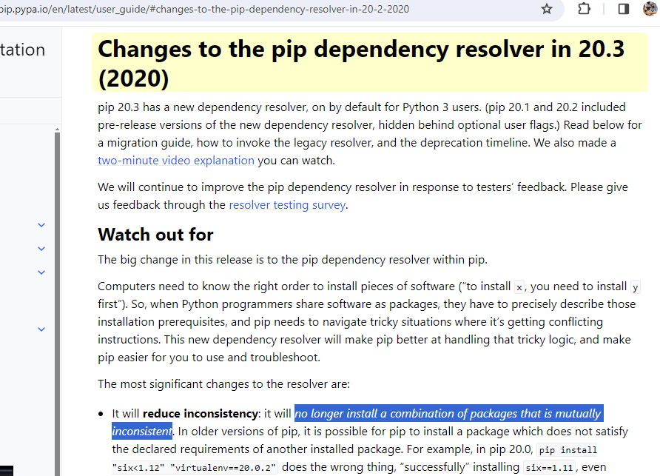
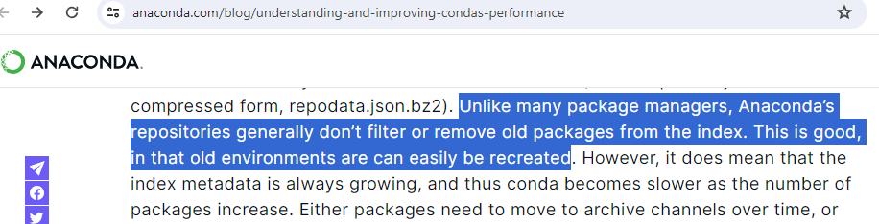
conda is better at dependency management
pip
conda’s constraint solver takes all dependencies into account
conda

Slide 26
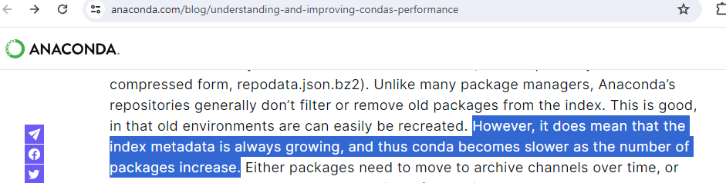
conda’s dependency manager can be a horrible user experience

Slide 27
conda’s dependency manager can be a horrible user experience
Pro-tips:
Use specific version numbers to reduce load on the dependency resolver
Use mamba solver: 50%-80% faster*
conda install flask=3.0.2 pandas=2.2.0 numpy
The dependency solver for conda was getting so slow that prominent users were declaring it unusable. A drop-in replacement, called mamba**, was created. The resolver for mamba is now integrated into conda.
conda config --show solver
conda config --set solver libmamba
*https://www.anaconda.com/blog/a-faster-conda-for-a-growing-community
** https://mamba.readthedocs.io/

Slide 28
TODO: Package management cheatsheet
Install packages
conda install numpy
pip install numpy

Slide 29
Enviornment management

Slide 30
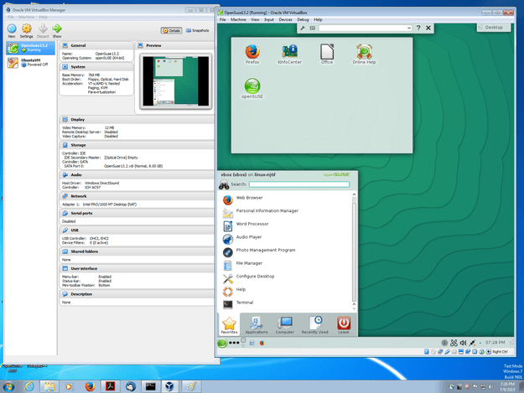
Virtual machines simulate isolated computers
Virtual machines can be run on your laptop to simulate multiple computers. Cloud services like DigitalOcean let users “rent” small computers for a few dollars a month – in reality many virtual machines share the same physical computer.
However, virtual machines have to simulate everything, including CPUs. This can slow computation.
https://www.virtualbox.org/attachment/wiki/Screenshots/OpenSuse13.2_on_Windows_7.png

Slide 31
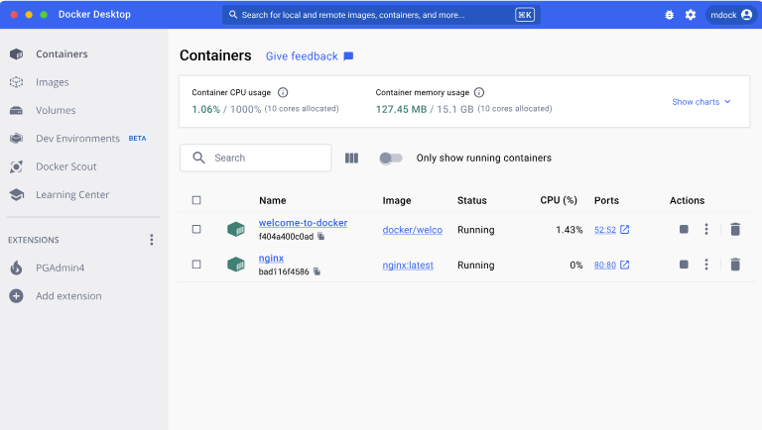
Containers, such as docker, simulate isolated processes
Docker uses linux’s built-in process isolation features. This allows a process to isolate its filesystem, memory and other operating system resources.
Docker does not need to simulate a full CPU and uses the existing linux kernel. This allows docker to be faster than virtual machines.
https://www.docker.com/products/docker-desktop/

Slide 32
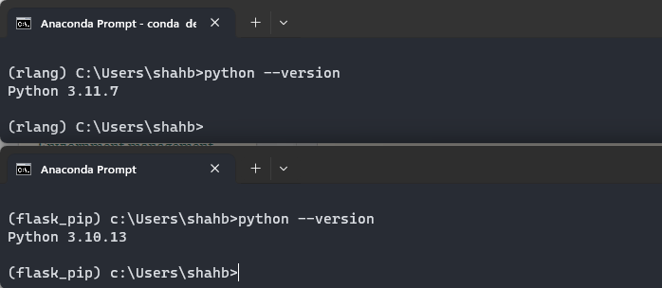
Environment managers isolate configurations
Environment managers such as conda and venv do NOT pretend that a program is running on its own, private, computer. The filesystem, memory and all other operating system resources are shared.
These tools DO isolate configurations (to varying degrees). Individual environments can have their own versions of programs, coexisting with other environments where programs of different versions can also exist.

Slide 33
Environment managers isolate configurations
Multiple environments allow users to:
Use different version of Python
Different versions of packages
Completely different packages
… on the same computer!

Slide 34
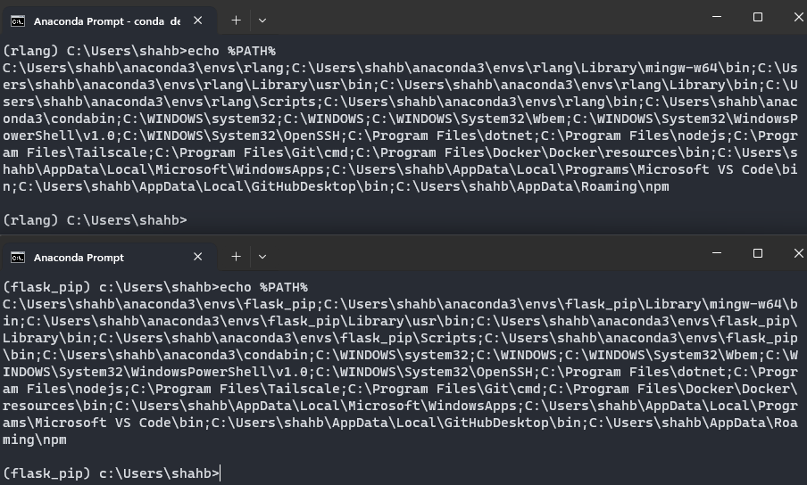
Envs are … mostly, a change in PATH

Slide 35
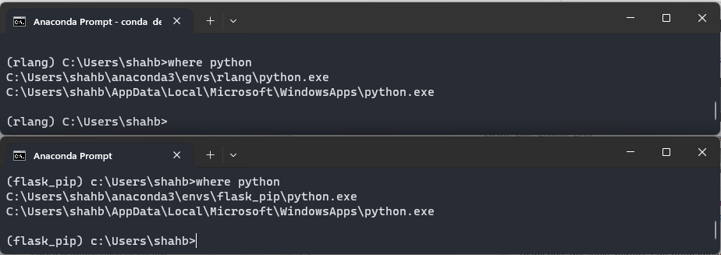
Envs are … mostly, a change in PATH

Slide 36
Poor man’s version of conda
poor_conda activate py36
OLD_INIT_SCRIPT = INIT_SCRIPT
OLD_PATH = PATH
PATH = py36/bin;OLD_PATH
Run py36/init_script.bat
poor_conda deactivate
PATH = OLD_PATH
Run OLD_INIT_SCRIPT

Slide 37
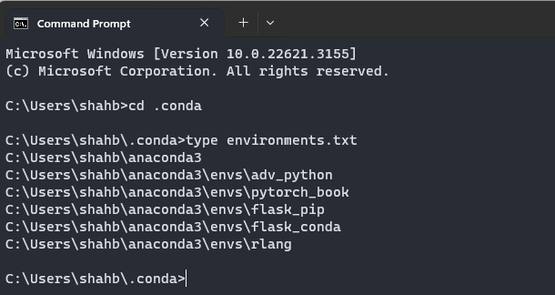
Creation of a new env means
conda create --name adv_python python=3.10
Creates an entry in ~/.conda/environments.txt

Slide 38
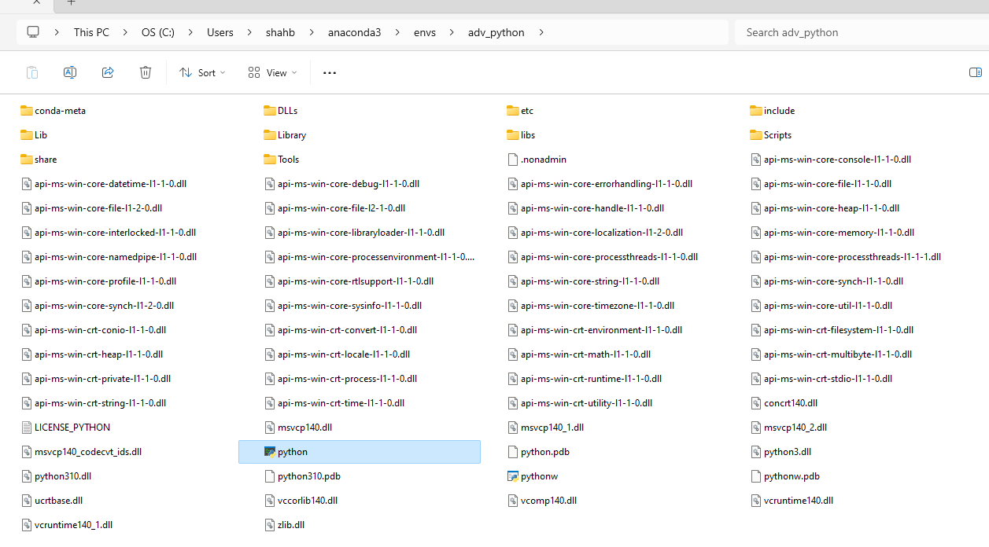
Creation of a new env means
conda create --name adv_python python=3.10
And populates ~/anaconda3/envs/adv_python

Slide 39

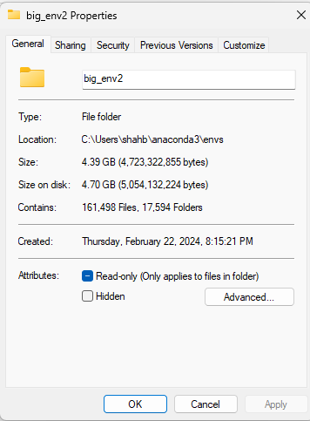
Pro-tip Rant: Create one env per project
Shared or common environments for the whole team just don’t work!
People will try to update or install packages, breaking the environment for everyone else ☹
conda create --name big_env1 python=3.10 r-essentials r-base
conda create --name big_env2 python=3.10 r-essentials r-base
Each environment is 4 GB!
Is the disk usage worth it?

Slide 40
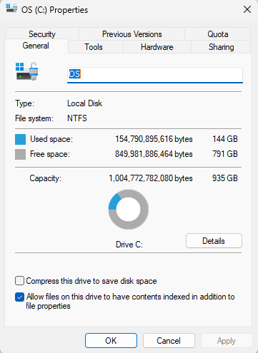
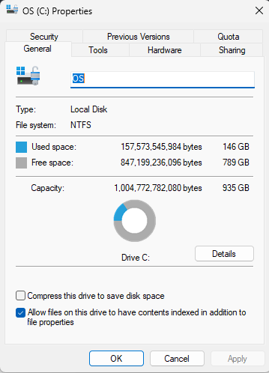
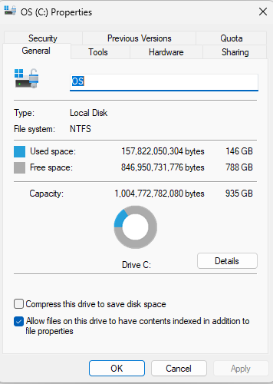
Pro-tip Rant: Create one env per project
Creating new environments is actually not very expensive:
Base
conda create --name big_env1 python=3.10
r-essentials r-base
conda create --name big_env2 python=3.10
r-essentials r-base
This env is less than 250 megs, NOT 4 GB!
154,790,895,616 bytes
157,573,545,984 bytes
157,822,050,304 bytes
Difference:
2,782,650,368 bytes
248,504,320 bytes, aka 248 megs

Slide 41
Pro-tip Rant: Create one env per project
Creating new environments is actually not very expensive.
The magic behind these storage savings is “hard links.”
cp file1 file2 will take up twice as much disk space as file1. Obviously. We have duplicated a file.
However, with soft links, ln -s file1 file2 LOOKS like it created a copy, but actually it only created a reference. It did not actually copy any content of file1. If you delete file1, file2 will disappear as well. Soft links are used quite often.
ln file1 file2 works similarly to soft links. However, deleting file1 does NOT remove file2.
Conda uses hard links, whenever it can. It downloads packages to a cache location and hard links packages to new environments. This is why the first big_env1 was so big and big_env2 was MUCH smaller.
warning: Hard links only work across the same disk. Hard links across network drives or different volumes will not work.

Slide 42
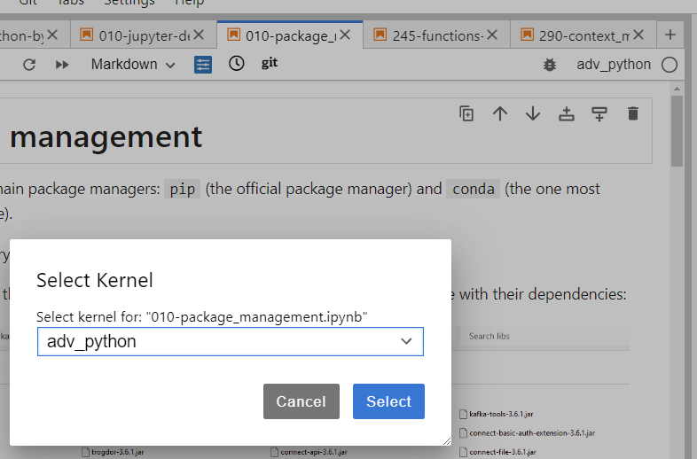
Pro-tip: Jupyter doesn’t see new environments!
Creation of new conda environments does NOT automatically make them accessible to Jupyter.
conda activate adv_python
pip install ipykernel
python -m ipykernel install --user --name adv_python --display-name "adv_python"

Slide 43
Pro-tip: Leave the base env alone!
Always create a new environment to test a package. Even if everything breaks, you can just remove the experimental environment via conda env remove --name exp_env
and create a new one.

Slide 44
Common package mgmt commands
Search for a package | conda search PACKAGE_NAME
List all installed packages | conda list
Install packages | conda install pandas=2.0 numpy=1.2
Upgrade packages | conda update pandas numpy
Remove packages | conda remove pandas numpy
https://docs.conda.io/projects/conda/en/4.6.0/_downloads/52a95608c49671267e40c689e0bc00ca/conda-cheatsheet.pdf

Slide 45
Common env mgmt commands
List environments | conda env list
Create a new environment | conda create --name adv_python python=3.10
Create a new env and install packages | conda create --name adv_python python=3.10 pandas numpy
Clone an environment | conda create --clone old_adv_python --name adv_python
Create an env based on a config | conda env create --file adv_python.yml
Save environment to a file | conda list –-explicit > adv_python.yml
Activate an environment | conda activate adv_python
Deactivate an environment | conda deactivate
Delete an environment | conda env remove --name adv_python
https://docs.conda.io/projects/conda/en/4.6.0/_downloads/52a95608c49671267e40c689e0bc00ca/conda-cheatsheet.pdf

Slide 46
You should know about ~/.condarc
Default .condarc
Useful additional properties
channels:
- defaults
channels:
- defaults
# default_channels:
# - https://repo.anaconda.com/pkgs/main
# - https://repo.anaconda.com/pkgs/r
envs_dirs: []
pkgs_dirs: []
# client_ssl_cert:
# client_ssl_cert_key:
proxy_servers: {}
ssl_verify: true
solver: libmamba
Your company may have its own package repo
If your company has firewalls which don’t allow direct internet connections, use a proxy
Sometimes SSL connections are more pain than they are worth (don’t do this in prod!)
All available options: https://conda.io/projects/conda/en/latest/configuration.html

Slide 47
Appendix
Some icons from https://icons8.com/

Slide 48
Benchmark code
#!/usr/bin/env python
# -*- coding: UTF-8 -*-
# Source: https://gist.githubusercontent.com/markus-beuckelmann/8bc25531b11158431a5b09a45abd6276/raw/660904cb770197c3c841ab9b7084657b1aea5f32/numpy-benchmark.py
# Roughly based on: http://stackoverflow.com/questions/11443302/compiling-numpy-with-openblas-integration
from __future__ import print_function
import numpy as np
from time import time
# Let's take the randomness out of random numbers (for reproducibility)
np.random.seed(0)
size = 1024
A, B = np.random.random((size, size)), np.random.random((size, size))
C, D = np.random.random((size * 128,)), np.random.random((size * 128,))
E = np.random.random((int(size / 2), int(size / 4)))
F = np.random.random((int(size / 2), int(size / 2)))
F = np.dot(F, F.T)
G = np.random.random((int(size / 2), int(size / 2)))
# Matrix multiplication
N = 20
t = time()
for i in range(N):
np.dot(A, B)
delta = time() - t
print('Dotted two %dx%d matrices in %0.2f s.' % (size, size, delta / N))
del A, B
# Vector multiplication
N = 5000
t = time()
for i in range(N):
np.dot(C, D)
delta = time() - t
print('Dotted two vectors of length %d in %0.2f ms.' % (size * 128, 1e3 * delta / N))
del C, D
# Singular Value Decomposition (SVD)
N = 3
t = time()
for i in range(N):
np.linalg.svd(E, full_matrices = False)
delta = time() - t
print("SVD of a %dx%d matrix in %0.2f s." % (size / 2, size / 4, delta / N))
del E
# Cholesky Decomposition
N = 3
t = time()
for i in range(N):
np.linalg.cholesky(F)
delta = time() - t
print("Cholesky decomposition of a %dx%d matrix in %0.2f s." % (size / 2, size / 2, delta / N))
# Eigendecomposition
t = time()
for i in range(N):
np.linalg.eig(G)
delta = time() - t
print("Eigendecomposition of a %dx%d matrix in %0.2f s." % (size / 2, size / 2, delta / N))
print('')
print('This was obtained using the following Numpy configuration:')
np.__config__.show()

Slide 49
Uses noctix lux theme on VS Code

